Slide 1



INTRODUCTION
HOA LAC HI-TECH PARK

Slide 2
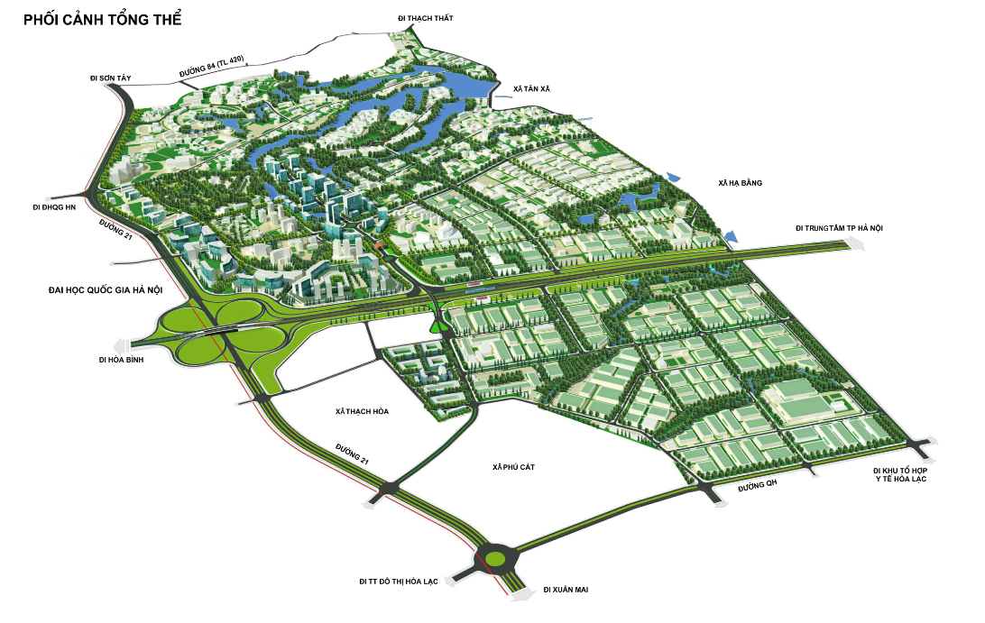

HOA LAC HI-TECH PARK
OVERVIEW
Location: Km 29, Thang Long Freeway,
Thach That Dist., Hanoi, Vietnam
Total Land Area: 1,586 ha
Purpose: Boosting regional and
national economic growth
Objectives:
Attracting hi-tech investment
Attracting hi-tech talent

Slide 3
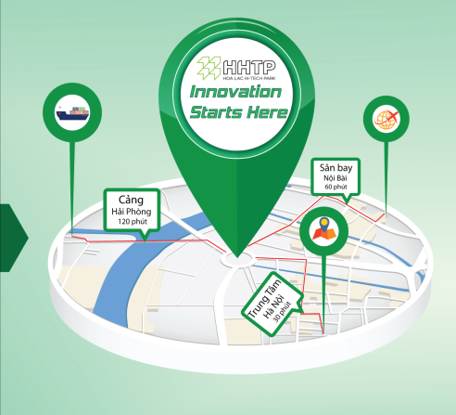
HOA LAC HI-TECH PARK
LOCATION
DISTANCE TO
HANOI: 30 mins
Noi Bai Int’ Airport
Hai Phong Port
NOI BAI INT’ AIRPORT: 60 mins
HAI PHONG PORT: 120 mins
Hanoi Center

Slide 4
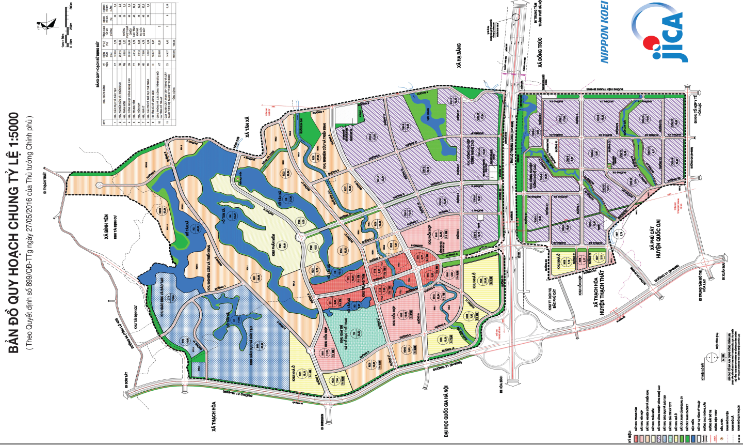
HOA LAC HI-TECH PARK
HHTP MASTER PLAN SCALE 1:5000
(According to Decision No.899/QD-TTg dated 27/5/2016 of the Vietnamese Prime Minister)
MASTER PLAN

Slide 5
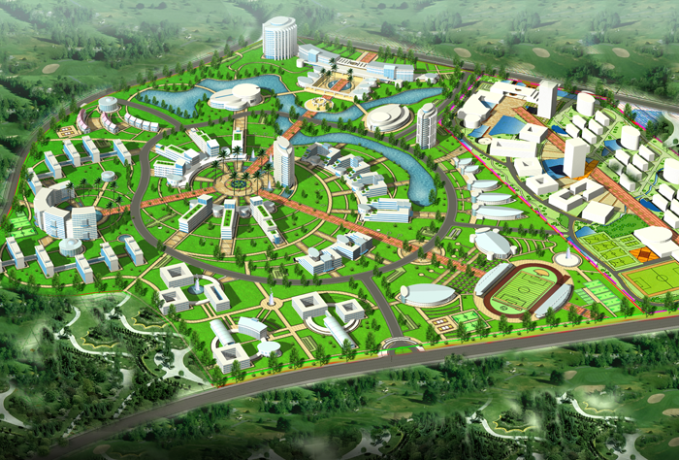
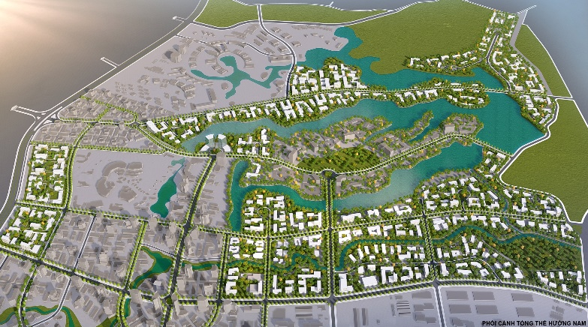
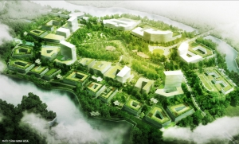
HOA LAC HI-TECH PARK
FUNCTIONAL ZONES
EDUCATION AND TRAINING ZONE
RESEARCH AND DEVELOPMENT ZONE
SOFTWARE PARK
Area: 123.5 ha
Occupation Rate: 55.7%
Area: 263 ha
Occupation Rate: 19.1%
Area: 56 ha
Occupation Rate: 34.2%

Slide 6
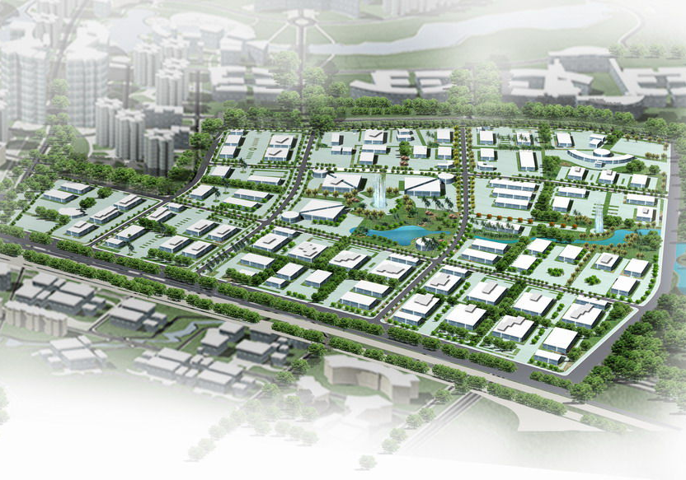
HOA LAC HI-TECH PARK
FUNCTIONAL ZONES
Developed by
FPT Hoa Lac Development Company
Total Area: 262 ha
Occupation Rate: 55%
HI-TECH INDUSTRIAL ZONE 1

Slide 7
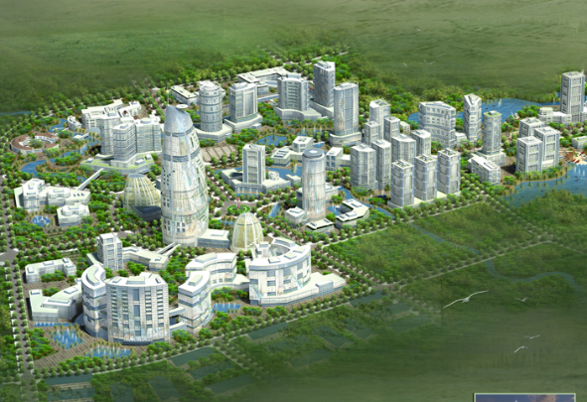
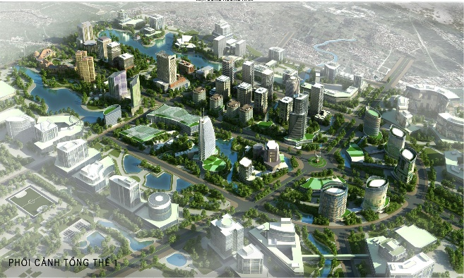
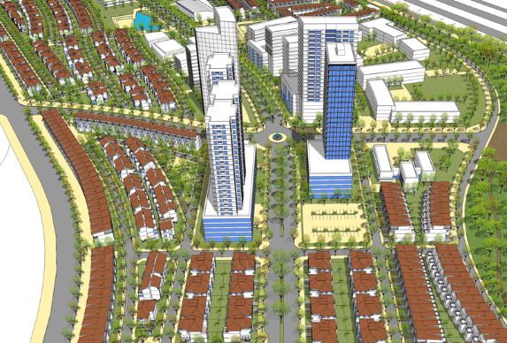
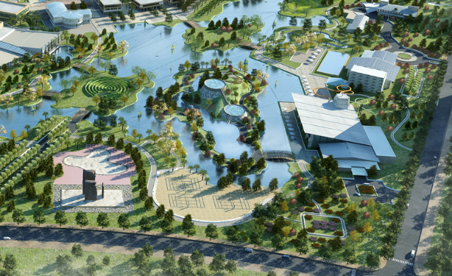
HOA LAC HI-TECH PARK
FUNCTIONAL ZONES
Utility Zones
CENTER AREA
Area: 43 ha
MIXED USE ZONE
Area: 80 ha
HOUSING AREA
Area: 75.5 ha
RECREATION AND SPORT AREA
Area: 33 ha

Slide 8


HOA LAC HI-TECH PARK
FIELDS OF INVESTMENT
HI-TECH
BIOTECHNOLOGY
Decisions No.38/2020/QD-TTg
of the Prime Minister
NEW MATERIAL TECHNOLOGY
AUTOMATION
INFORMATION TECHNOLOGY

Slide 9

HOA LAC HI-TECH PARK
CRITERIA OF INVESTMENT
 | Advanced Technology
 | 1/3 Automatic devices
 | Expenses in R&D Activities
 | At least 1% annual turnover
 | Number of Engineers
 | At least 5% of total employees in R&D
Environmental Standard
 | TCVN ISO 14000
 | Others
- Effectively used land -Remarkable amount of investment capital - Etc

Slide 10

HOA LAC HI-TECH PARK
INVESTMENT INCENTIVES
0%
5%
10%
20%
Year 1 - 4
Year 5 - 13
Year 14 - 15
From year 16
Year 14 – 30
(Capital > 4,000 bil. VND
≈ 175 mil. USD)
From year 30
(Capital > 4,000 bil. VND
≈ 175 mil. USD)

Slide 11
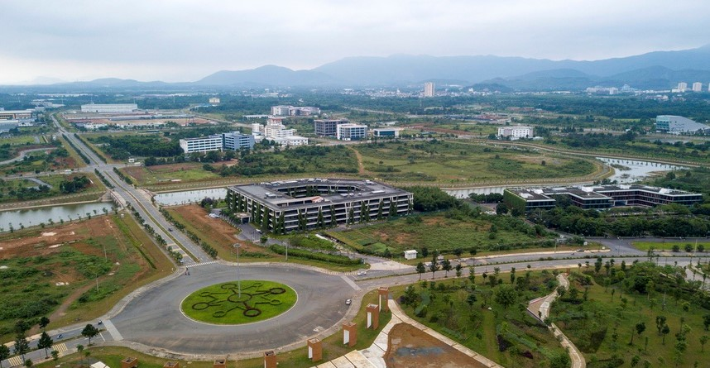
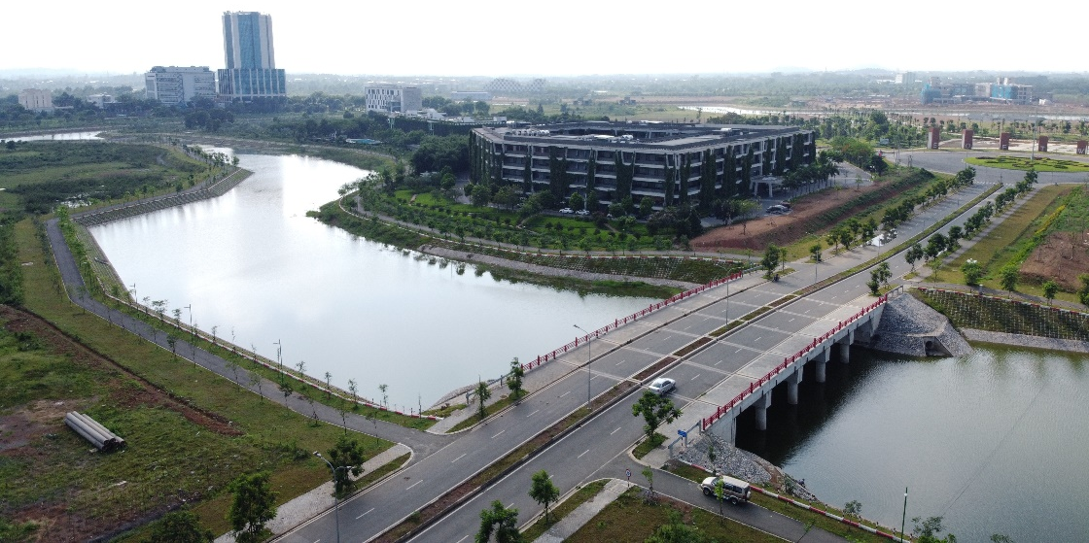
HOA LAC HI-TECH PARK
INFRASTRUCTURE
Wastewater treatment:
42,000 m3 per day
Stable water supply system, great pressure with a capacity of 43,000 m3 per day
The telecommunications system has a capacity of nearly 300,000 numbers, about 282km of communication pipelines
Electrical system with 3 x 63 MVA

Slide 12
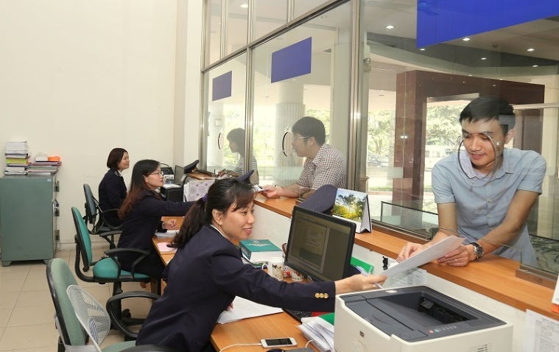
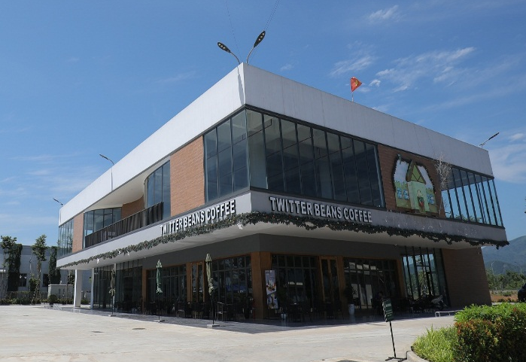
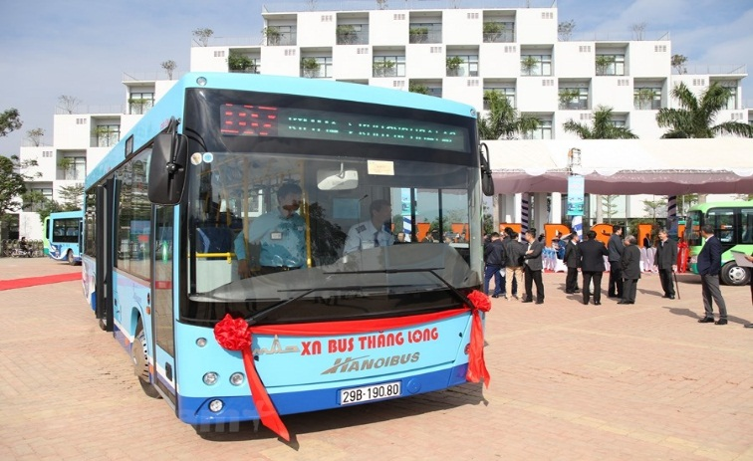
HOA LAC HI-TECH PARK
UTILITY SERVICES
One-stop Services
Banking, customs, logistics…
Bilingual School
Convenient public transport, connecting with Hanoi capital

Slide 13
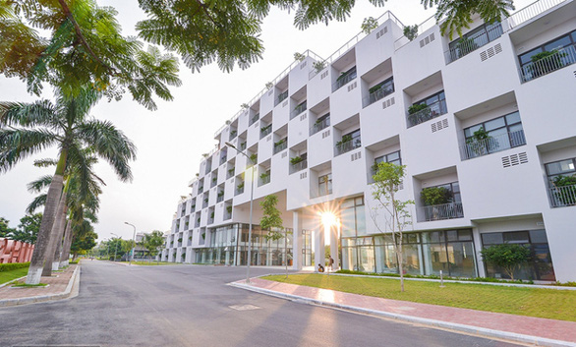
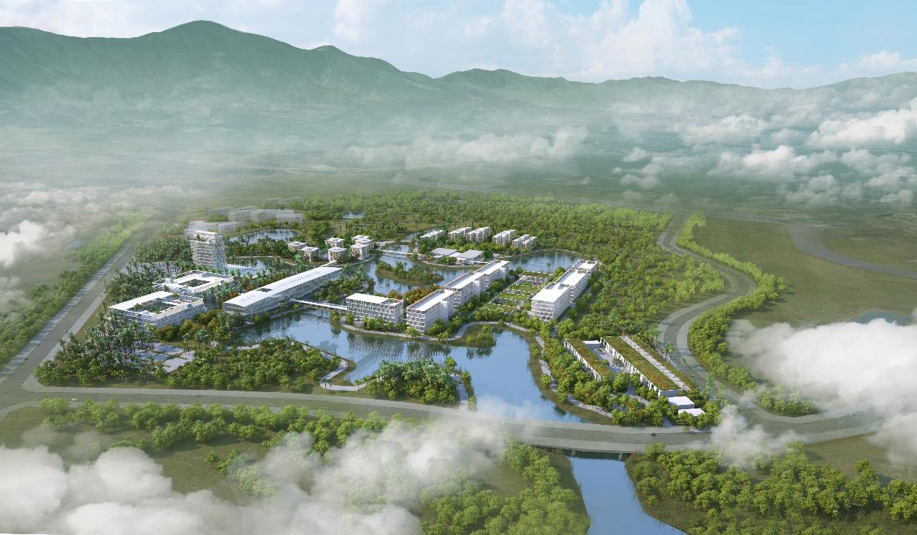
TRAINING AND RESEARCH DEVELOPMENT
04 Universities
HOA LAC HI-TECH PARK
FPT University: currently has about 9,000 students, plans to train 12,000 students
Hanoi University of Science and Technology (Vietnam - France University): scale of 10,500 students
Van Lang University: scale of 15.000 students
Vietnam – Japan University
- Training programs: information and communication technology; mechatronic engineering technology; agro-medical biotechnology; aviation technique; advanced materials science and nanotechnology; electrical engineering and renewable energy; space science and satellite technology; data science; robotics and automation; business administration, international business;…

Slide 14
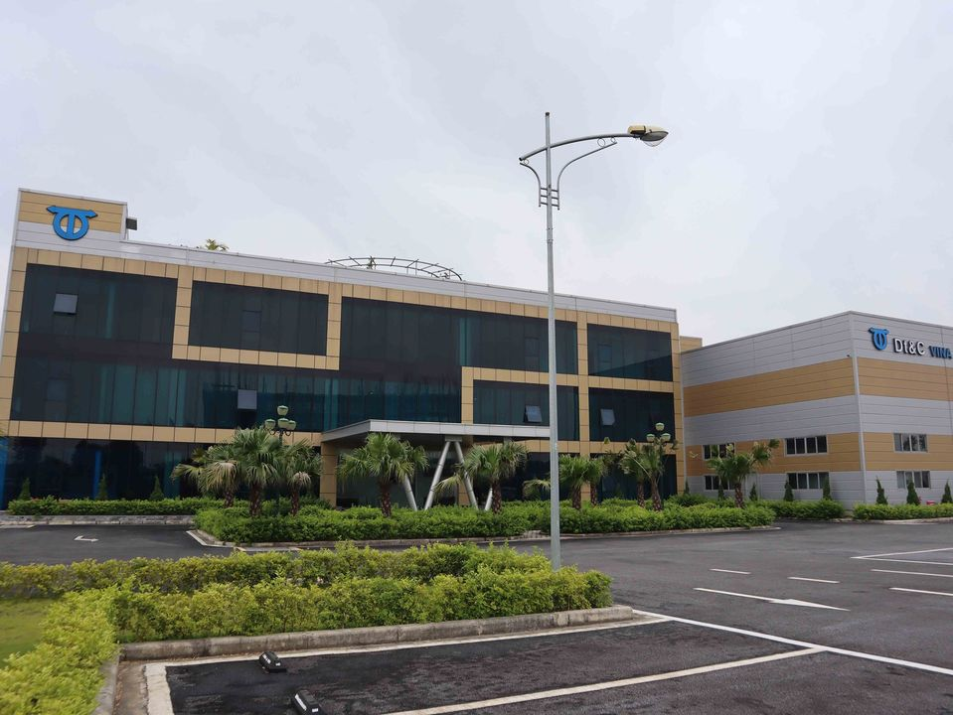
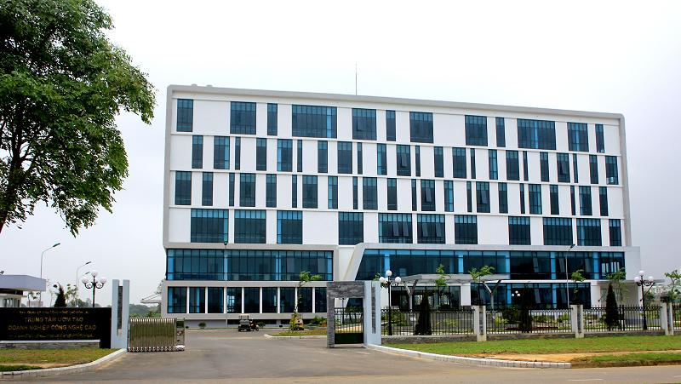
HOA LAC HI-TECH PARK
TRAINING AND RESEARCH DEVELOPMENT
06 R&D, start-up, innovation support agencies
IoT Innovation Hub
National Innovation Center (NIC)
Center for Research, Development and Start-up Support SSI
Technical Center for Industrial Development Support in the North, Department of Industry, Ministry of Industry and Trade
Research and Development Support Center of DT&C Company
Hi-tech Incubation and Training Center

Slide 15
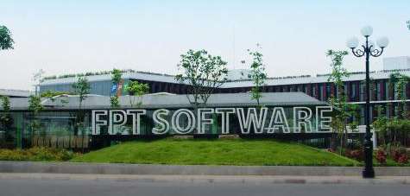
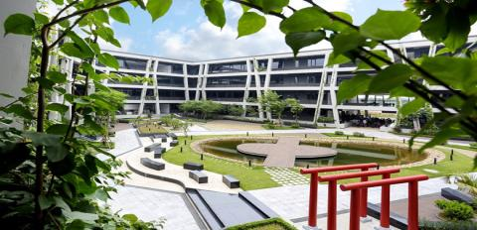
SOFTWARE DEVELOPMENT
HOA LAC HI-TECH PARK
FPT Software: over 5,000 software engineers currently working in Hoa Lac campus
Viettel, ETC, BKAV ... projects are in operation

Slide 16
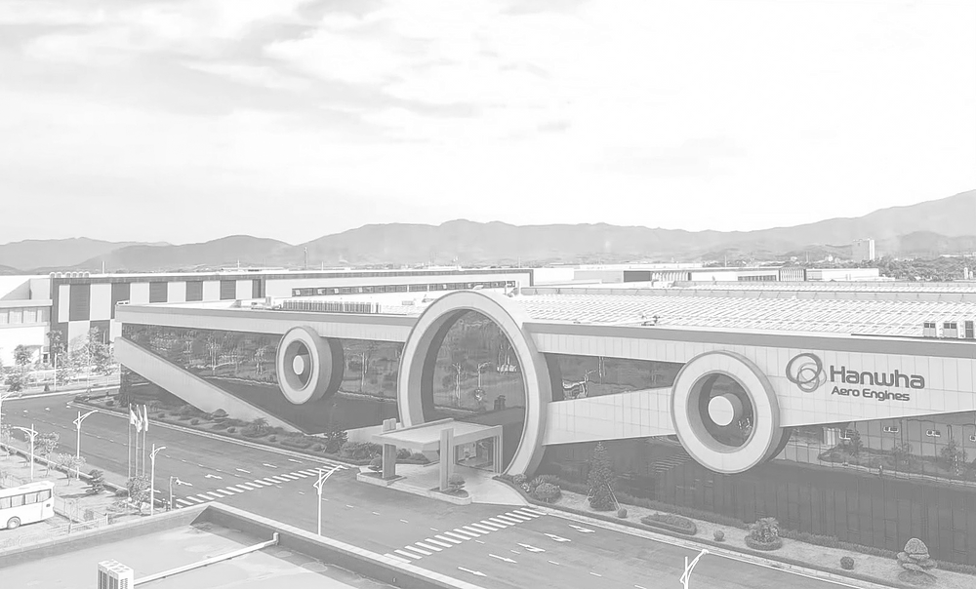

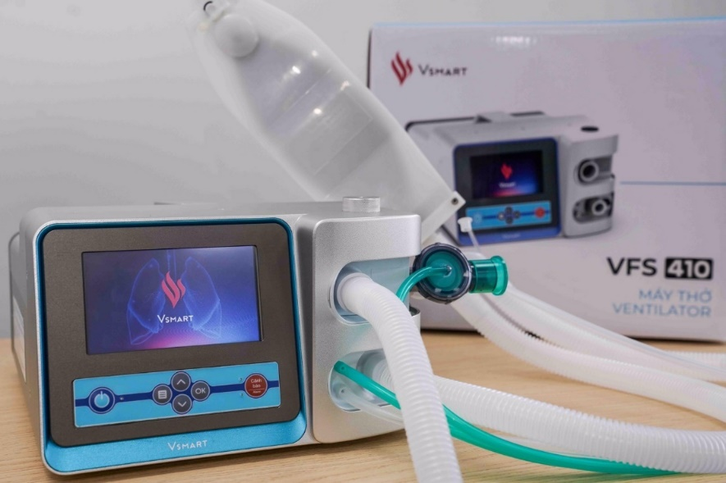
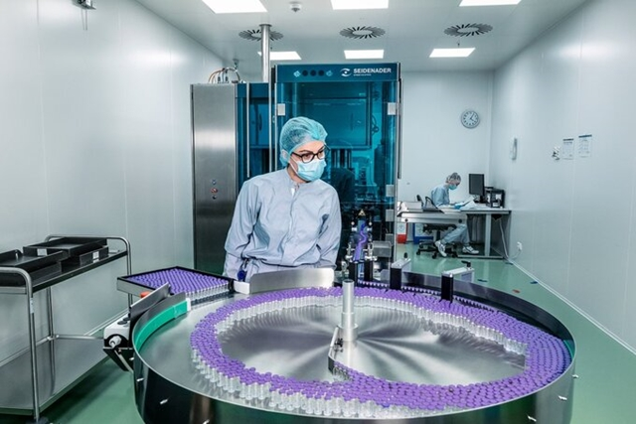
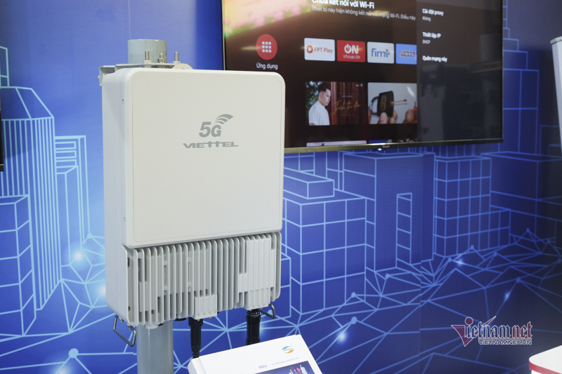
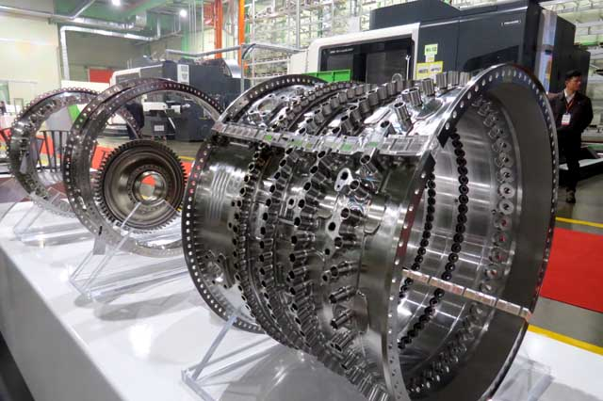
HOA LAC HI-TECH PARK
HI-TECH INDUSTRIAL ZONE

Slide 17

HOA LAC HI-TECH PARK
COME AND GROW WITH US

Slide 18
HOA LAC HI-TECH PARK
WHY HHTP?
HIGH QUALITY HUMAN RESOURCES
MODERN SYNC INFRASTRUCTURE
ONE-STOP SERVICES
CONVENIENT TRAFFIC CONNECTIONS
STRATEGIC LOCATION

Slide 19
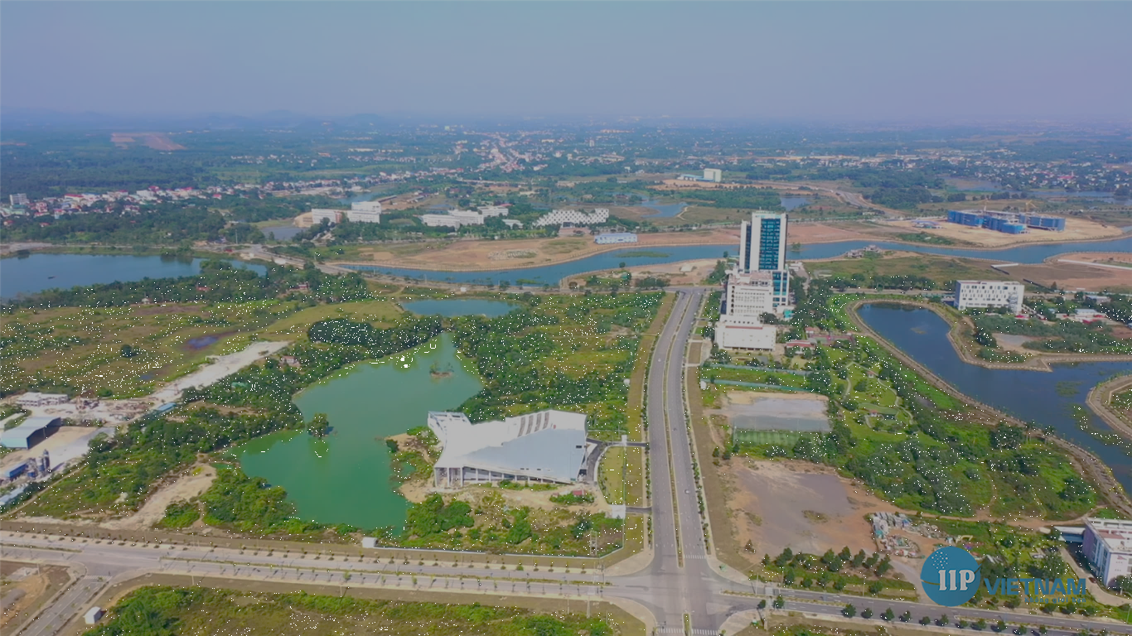
THANK YOU
FOR YOUR ATTENTION!
For further information, kindly contact:
Han Tuan Anh (Mr.)
Deputy Director of FPT Hoa Lac
Mob: +84 916188558
Email: anhht@fpt.com

